Slide 1


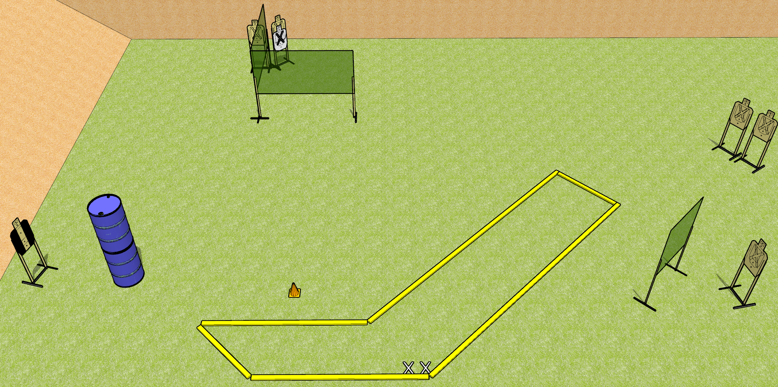
 | Dothan Gun Club – USPSA Match Check it Out Course Designer : Drew Coleman
START POSITION : Standing with both feet on X’s, wrists below belt
GUN READY CONDITION : Pistol loaded and holstered. PCC loaded, held with both hands, shouldered, safety on, pointed at orange cone. |  | SCORING: Virginia Count, 12 rounds TARGETS: 6 paper, 0 Steel SCORED HITS: Best 2 on paper, steel until down START-STOP: Audible, last shot RULES:
STAGE PROCEDURE: Engage targets as they become available from within the fault lines.

Slide 2
Check it Out
Written Stage Briefing
Check it Out is a 12 round, 60 point, Virginia count short course. There are six USPSA targets. The best two hits per target will score. The start signal is audible.
Handgun start position is standing with both feet on X’s, wrists below belt. Handgun is loaded and holstered.
PCC start position is standing with both feet on X’s, muzzle pointed at orange cone. Loaded carbine is held with both hands, shouldered, safety on.
On start signal, engage each target with only two rounds each from within the shooting area.

